Slide 1
Kafka Introduction
Developed by LinkedIn

Slide 2
Kafka
Distributed publish-subscribe messaging system
Partitioned and replicated commit log service
Persist messages on disk by a due date

Slide 3
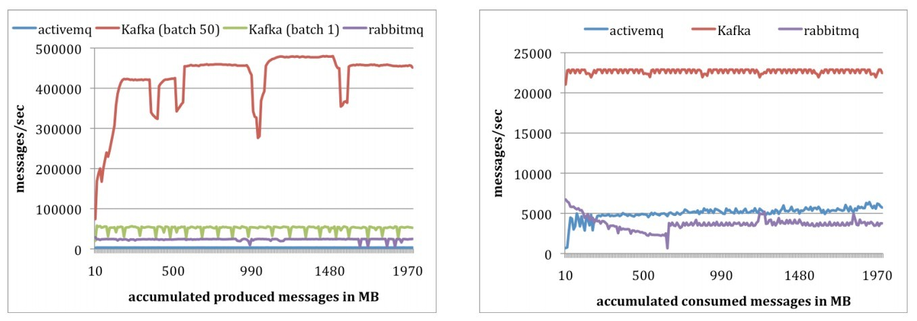
Performance
High Throughput
Zero Copy
Use Linux sendfile system call
http://stenlyho.blogspot.tw/2008/08/zero-copy.html
Notes:
http://stenlyho.blogspot.tw/2008/08/zero-copy.html

Slide 4
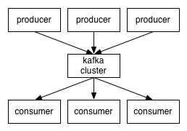
Component
Message
Topic
Each message attribute to one Topic
Message category
Producer
Broker
Kafka cluster contain multiple broker
Consumer

Slide 5
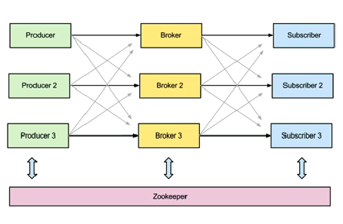
Kafka Architecture

Slide 6
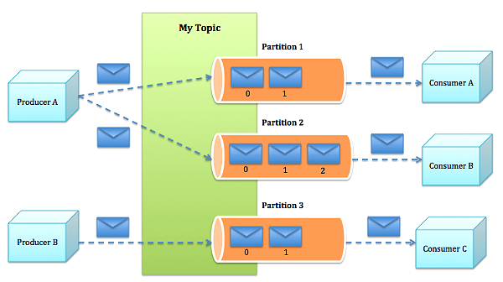
Kafka Architecture
Append partition log file
Consumer maybe multiple processes or multiple threads

Slide 7
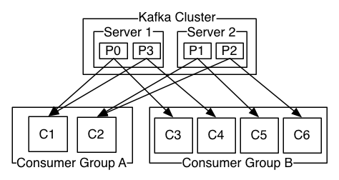
Kafka Architecture
Consumer basic unit : Consumer Group
A consumer group stand for one process or one machine,
Each consumer group can contains multiple consumers (threads) for parallel

Slide 8
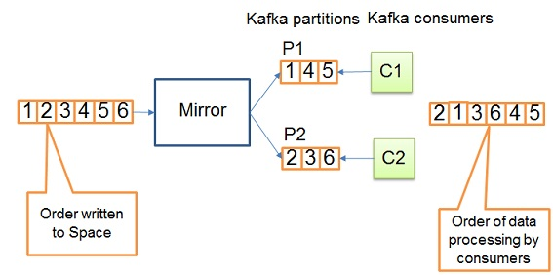
Partition Message
Only prove partition in order in this topic,
Not all partitions in order
If we want all in order, then partition should be only one

Slide 9
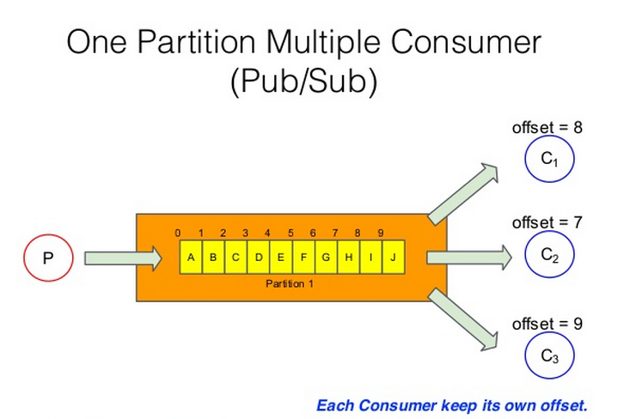
Partition Message

Slide 10
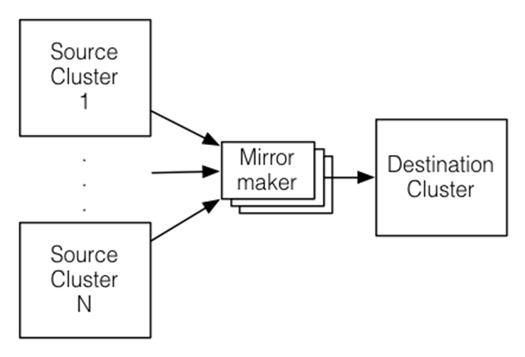
Mirroring Data between Clusters
bin/kafka-run-class.sh kafka.tools.MirrorMaker
--consumer.config consumer-1.properties --consumer.config consumer-2.properties
--producer.config producer.properties –whitelist mytopic
bin/kafka-run-class.sh kafka.tools.MirrorMaker
--consumer.config consumer-1.properties --consumer.config consumer-2.properties
--producer.config producer.properties –whitelist ’*’

Slide 11
Reference
http://stackoverflow.com/questions/16946778/how-can-we-create-a-topic-in-kafka-from-the-ide-using-api
https://www.ibm.com/developerworks/linux/library/j-zerocopy/
https://cwiki.apache.org/confluence/display/KAFKA/Compression
https://cwiki.apache.org/confluence/display/KAFKA/Consumer+Group+Example
https://cwiki.apache.org/confluence/display/KAFKA/0.8.0+SimpleConsumer+Example
http://kafka.apache.org/082/javadoc/index.html?org/apache/kafka/clients/producer/KafkaProducer.html
https://cwiki.apache.org/confluence/display/KAFKA/Clients

Slide 12
Scenario: Line Like
Client as two roles – producer and consumer
Client sends message to others clients in chat-room
Kafka topic name is chat-room name which is unique
Client message as Kafka message is categorized by Kafka Topic
Kafka mainly purpose is as a temp message file system to solve clients which disconnect in chat-room and recovered by Kafka system

Slide 13
Thanks for your attention

